Slide 1
Functional Units Of A Computer By M.BABY ANUSHA Asst. Professor, CSE Department RAMACHANDRA COLLEGE OF ENGINEERING

Slide 2
Computer Architecture
A computer organization describes the functions and design of the various units of digital computers.
Computer Architecture is defined as the functional operation of the individual h/w unit in a computer system.
A computer architecture deals with the specification of an instruction set and the hardware units that implement the instructions.
A computer hardware consists of electronic circuits, displays, magnetic and optic storage media and also the communication facilities.

Slide 3
Functional units
Functional units is a part of a CPU that performs the operations and calculations called for by the computer program.
Computer consists of five main parts namely,
Input unit,
Central Processing Unit
Memory unit
Arithmetic & logical unit
Control unit
Output unit

Slide 4
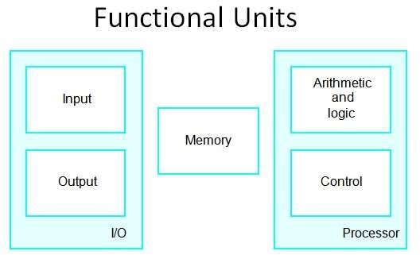
1. Input Unit
Input units are used by a computer, which read the data.

Slide 5
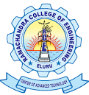
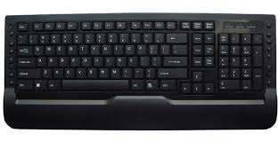
The most commonly used input devices are,
Fig: Keyboard

Slide 6

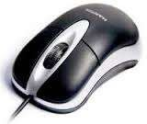
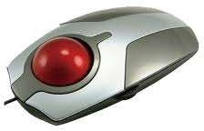
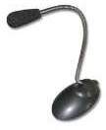
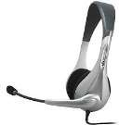
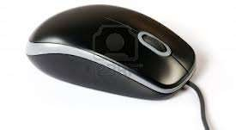
Fig: joysticks
Fig: Trackballs
Fig: Mouse
Fig: Microphones

Slide 7
Memory unit
Memory unit is used to store programs and data.
Two types of memory exist. they are,
Primary storage, and
Secondary storage
Primary storage:
Primary memory contains a large number of semiconductor storage cells, capable of storing a bit of information.
The bits of information are grouped into fixed size words. The word length of a computer is between 16-64 bits.
Addresses are used to access the words from memory. Addresses are numbers that identifies locations.

Slide 8
The memory is know as main memory in which program must resides.
Cache is also a kind of memory which is used to access the data very
soon. they are highly coupled with the processor.
Example: RAM,ROM.
Advantages: Small, and Fast
Disadvantages:
less storage capacity, and costly

Slide 9
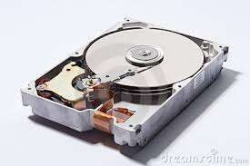
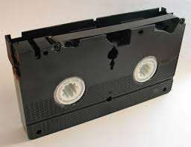
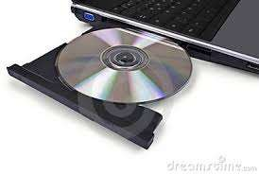
Secondary storage:
Secondary memory are used when large amount of data and programs have to be stored.
Example:
Magnetic disks, Magnetic tapes, and Optical disks.
Fig: Magnetic disk
Fig: Magnetic tapes
Fig: Optical disk

Slide 10
Arithmetic and logic unit:
Most of all the operations of a computer are executed in the ALU of the processor.
It perform arithmetic operations like addition, subtraction, multiplication, division and also the logical operations like AND, OR, NOT operations.

Slide 11
Output unit
Output units are used to send the processed results to the user.
Output devices display information in a way that you can
understand. The most common output device is a monitor.
Output devices are pieces of equipment that are used to get information or any other response out from computer. These devices display information that has been held or generated within a computer.

Slide 12
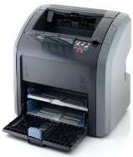
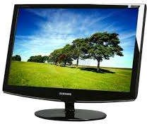
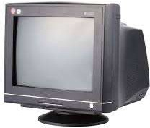
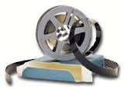
Some of the output units are,
Fig: Printer
Fig: Graphics Displays
Fig: CRT Displays
Fig: Microfilm

Slide 13
Control unit
Control unit is used to coordinate the operations of the input, output, memory, ALU in some way. It coordinates the operation of all the units using control signals like timing signals.
Timing signals are the signals determining the time when a given action must take place. A large set of control lines carriers the signals used for timing and synchronization of events in all units.

Slide 14
THANK YOU

